Slide 1
Physics-Constrained Neural Network-Based Load Torque Observer for Traction Electric Machine
A. H. Safder, A. Hanif and Q. Ahmed, "Physics-Constrained Neural Network-Based Load Torque Observer for Traction Electric Machine," 2024 IEEE Conference on Control Technology and Applications (CCTA), Newcastle upon Tyne, United Kingdom, 2024, pp. 114-119, doi: 10.1109/CCTA60707.2024.10666631.

Slide 2
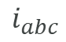

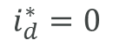
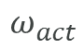
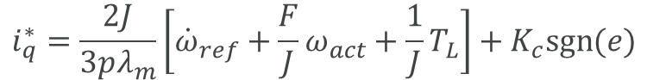
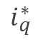
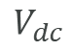

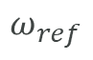
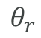
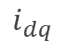
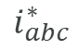
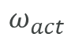

System block diagram
Battery
$$i_{q}^{∗}=\frac{2J}{3pλ_{m}}\left[{\dot{ω}}_{ref}+\frac{F}{J}ω_{act}+\frac{1}{J}T_{L}\right]+K_{c}sgn⁡(e)$$
$$ω_{ref}$$
$$V_{dc}$$
Speed Controller
Inverse Clark and inverse Park transformation
$$i_{abc}^{∗}$$
Hysteresis Current Controller
Inverter
$$e$$
$$i_{q}^{∗}$$
PWM
$$ω_{act}$$
$$T_{L}$$
$$i_{d}^{∗}=0$$
$$θ_{r}$$
$$i_{abc}$$
$$θ_{r}$$
EM
Torque Observer
$$i_{dq}$$
Clark Park transformation
$$ω_{act}$$

Slide 3
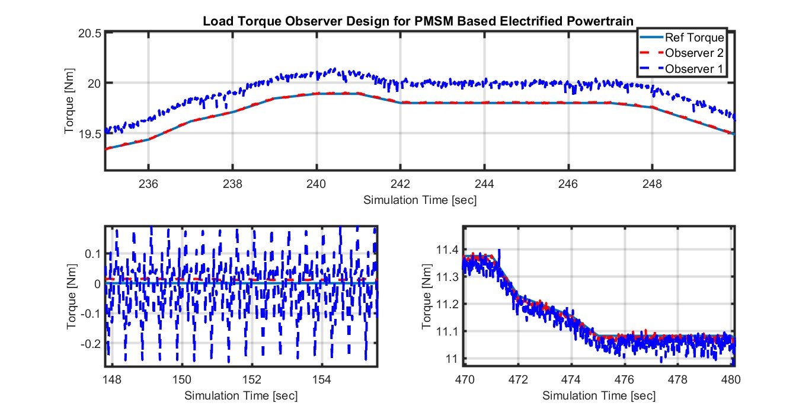
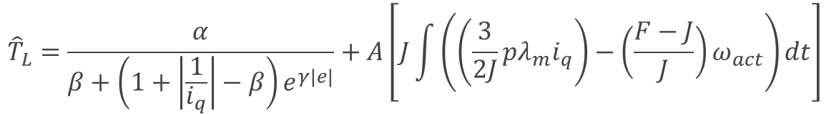
Torque observer – Dynamics based
$${\hat{T}}_{L}=\frac{α}{β+\left(1+\left|\frac{1}{i_{q}}\right|−β\right)e^{γ|e|}}+A\left[J\int{\left(\left(\frac{3}{2J}pλ_{m}i_{q}\right)−\left(\frac{F−J}{J}\right)ω_{act}\right)}dt\right]$$
A dynamics-based torque observer has extensive computational requirements
Difficult to implement on hardware
The estimation of load torque will be highly accurate

Slide 4

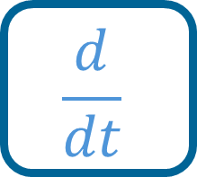
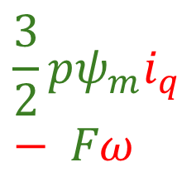
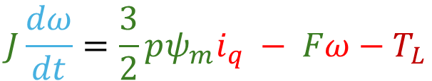

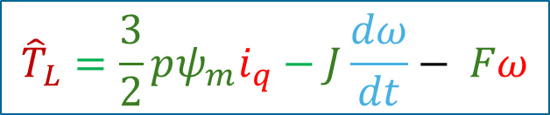
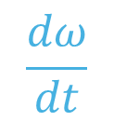


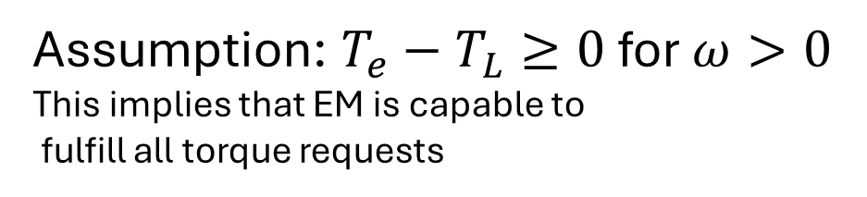
Physics Constraint Neural Network (PCNN) Torque Observer
System Dynamics
$$J\frac{dω}{dt}=\frac{3}{2}pψ_{m}i_{q} − Fω−T_{L}$$
Unknown
Feedback states
Constant
Computed
$$T_{e}$$
Assumption: $T_{e}−T_{L}≥0$for $ω>0$
This implies that EM is capable to
fulfill all torque requests
$$\frac{dω}{dt}$$
$$ω$$
$$\frac{d}{dt}$$
$${\hat{T}}_{L}$$
Physics based constraint
$${\hat{T}}_{L}=\frac{3}{2}pψ_{m}i_{q}−J\frac{dω}{dt}− Fω$$
$$\frac{3}{2}pψ_{m}i_{q}− Fω$$
(Predicted torque should obey the dynamics)
Powertrain level constraint
$$λ_{gear}T_{L min}<\frac{3}{2}pψ_{m}i_{q} − Fω−J\frac{dω}{dt}<λ_{gear}T_{L max}$$

Slide 5
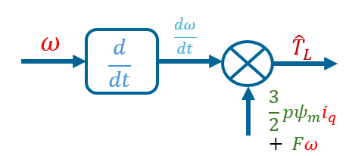
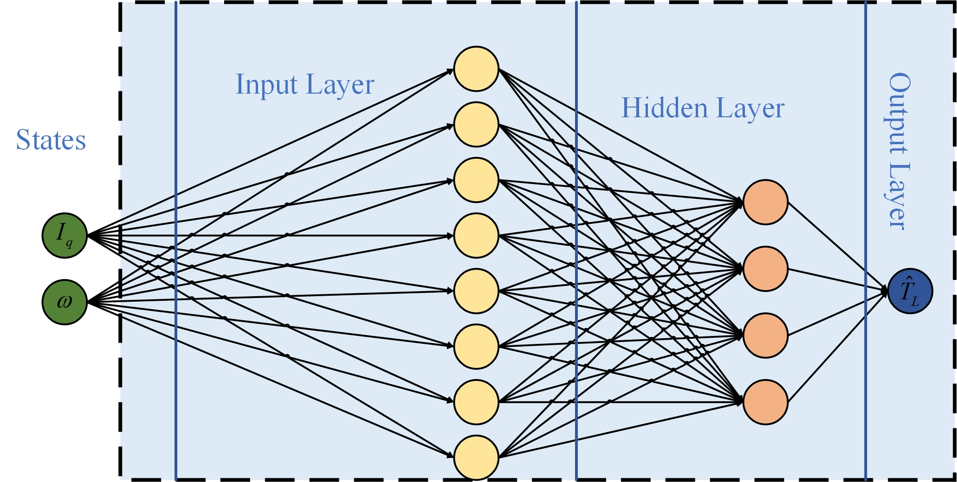
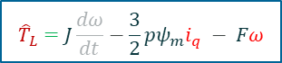
Physics Constraint Neural Network (PCNN) Torque Observer
System Dynamics
$${\hat{T}}_{L}=J\frac{dω}{dt}−\frac{3}{2}pψ_{m}i_{q} − Fω$$
$$θ=ζ_{m}{∑\left(T_{L_{data}}[i]−{\hat{T}}_{L_{net}}[i]\right)}^{2}+ζ_{p}{∑\left(\frac{3}{2}pψ_{m}i_{q}\left[i\right]− Fω\left[i\right]−J\frac{dω}{dt}[i]−{\hat{T}}_{L}[i]\right)}^{2}$$
MSE Loss
Physics Based Loss

Slide 6
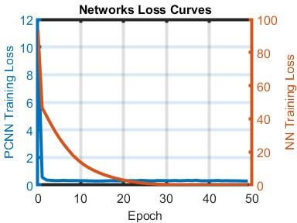
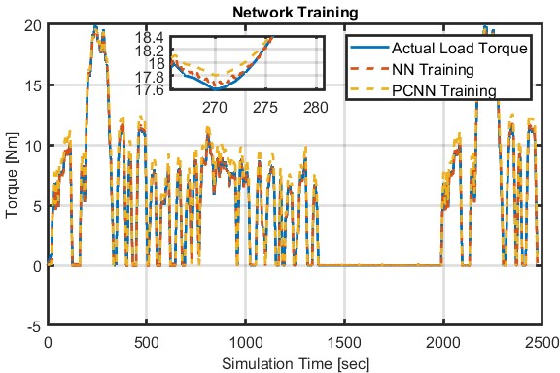
PCNN Training

Slide 7
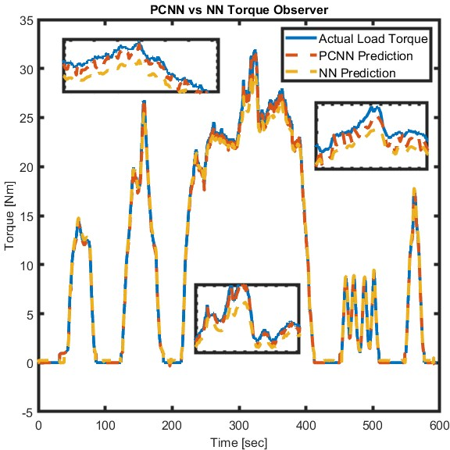
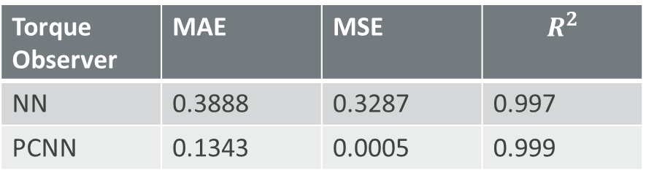
PCNN Validation (US06)
US06 has mostly operating points similar to FT75 speed profile
PCNN and NN performance is comparable
Torque Observer | MAE | MSE | $$R^{2}$$
NN | 0.3888 | 0.3287 | 0.997
PCNN | 0.1343 | 0.0005 | 0.999

Slide 8
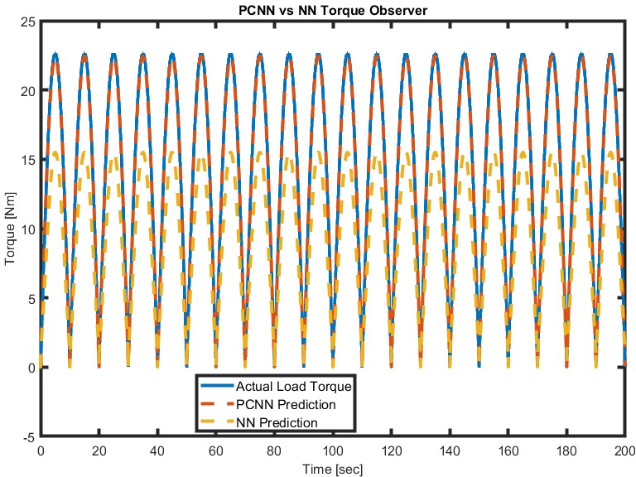
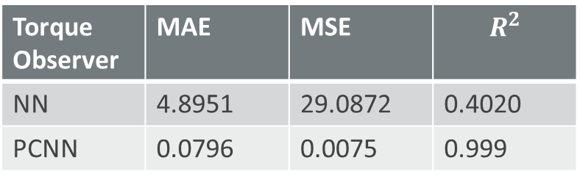
PCNN Validation (Sinusoidal)
Sinusoidal waveform helps to test the performance of torque observers under fluctuation
It also tests the capability of extrapolation
NN fails to predict load torque
Torque Observer | MAE | MSE | $$R^{2}$$
NN | 4.8951 | 29.0872 | 0.4020
PCNN | 0.0796 | 0.0075 | 0.999

Slide 9
Thank you
Contact:
Ahmad Hussain Safder (safder.1@osu.edu)
Athar Hanif (hanif.6@osu.edu)
Qadeer Ahmed (ahmed.358@osu.edu)

